Slide 1
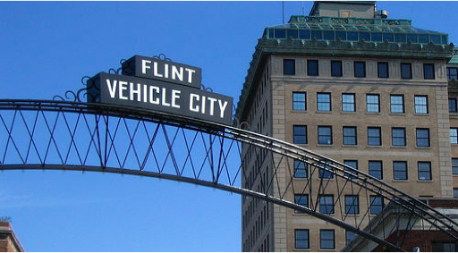

opendataflint.org
Open Data Flint
v
Notes:
I am here to tell you about open data flint, a project of the HFRCC and my organization ICPSR.
What we are building for the community of Flint has some unique features that reflect a repository’s take on open data.
Our goal is to make not only publicly available data, like Census data, accessible to the broader public, but also the kinds of data collected under the broad Federal mandate for scientific research.
And, for reasons that I will remind you of in the next 5 minutes, using data to help the community of Flint understand its economic position and be part of the broader conversation in Michigan, is what has shaped out project.

Slide 2
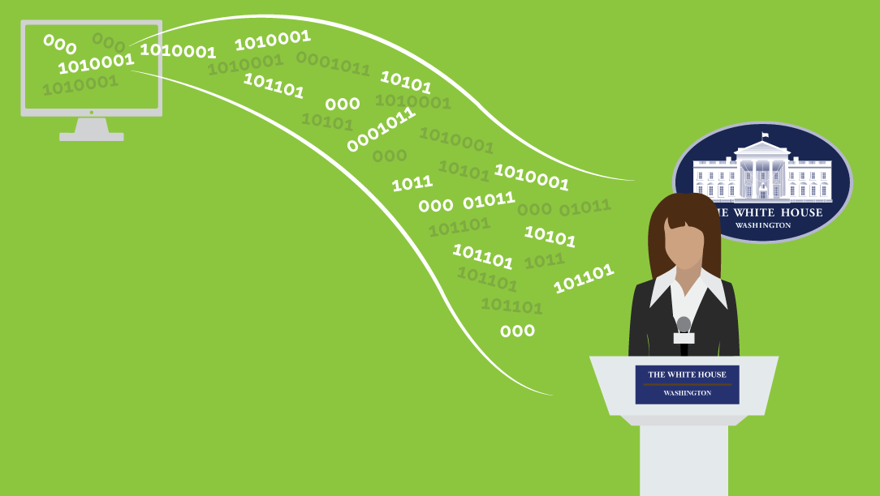
ICPSR excels at
Metadata
creation
Notes:
ICPSR is...
Over 50 years of experience disseminating data
We give broad public access to 10,000 studies most of which are downloadable but we also provide access to data requiring data use agreements and we run a high security physical enclave.
ICPSR is housed at the U-M, but we are made up of a broad network in the social sciences with 760 member institutions worldwide.
ICPSR has built its global reputation as a leader in the creation and management metadata.
Metadata allow user communities to find and use data in order to tell their stories so that society understands itself and can improve.
ICPSR has tools, standard, and a staff of curators making us really good at producing high quality metadata.
We partner with Federal agencies like BJS, various institutes at NIH, NEA, and Administration for Children and Families, to create and distribute metadata-rich data.

Slide 3
Why Flint?
Notes:
Because of the Flint water crisis, there has been an increased amount of research about the impact of the lead in the water efforts to rebuild the health of the community along with strengthening the economic and social base in Flint because we know that the issues are interconnected.
U-M; U-M Flint and MSU are partnering with the Flint community to coordinate this research.
One of the initiatives from this partnership has been to build Open Data Flint -- a online access point for the community to the research that is ongoing.

Slide 4
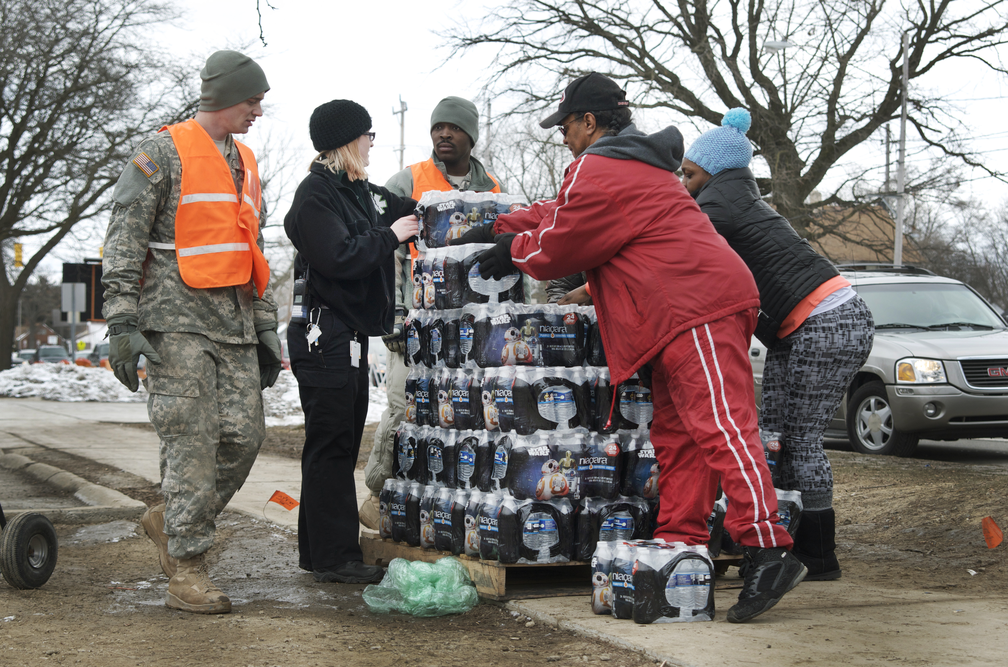
Working with Community
Partners
In Flint
Notes:
One of the novel aspects of our Open Data model is that it comes from a community and academic partnership. Our Community Based Organization Partners is an umbrella organization comprised of Community Based Organizations who together are tasked to educate, train, research and mobilize underrepresented, underserved, and under-resourced grass root communities. This organization is working to achieve equity in health and social justice priorities.
Community partners in Flint help us select our data acquisition priorities and give advise on developing access and the community’s capability for using the data.
We are committed to ongoing evaluation of what we build so that we can re-engineer our content and delivery of the content for even greater impact.

Slide 5

Available
Flint Data
Notes:
opendataflint.org is a simple web page linking to several data sets about Flint. This is a word cloud of the data descriptions.
We are working with several long-term longitudinal studies funded by NIH conducted in the Flint community following adolescence and young adults over time to add data.
Some of the data have access restrictions. These restricted data can also be open data. We support users wishing to gain access to the restricted data to meet the access requirements.

Slide 6
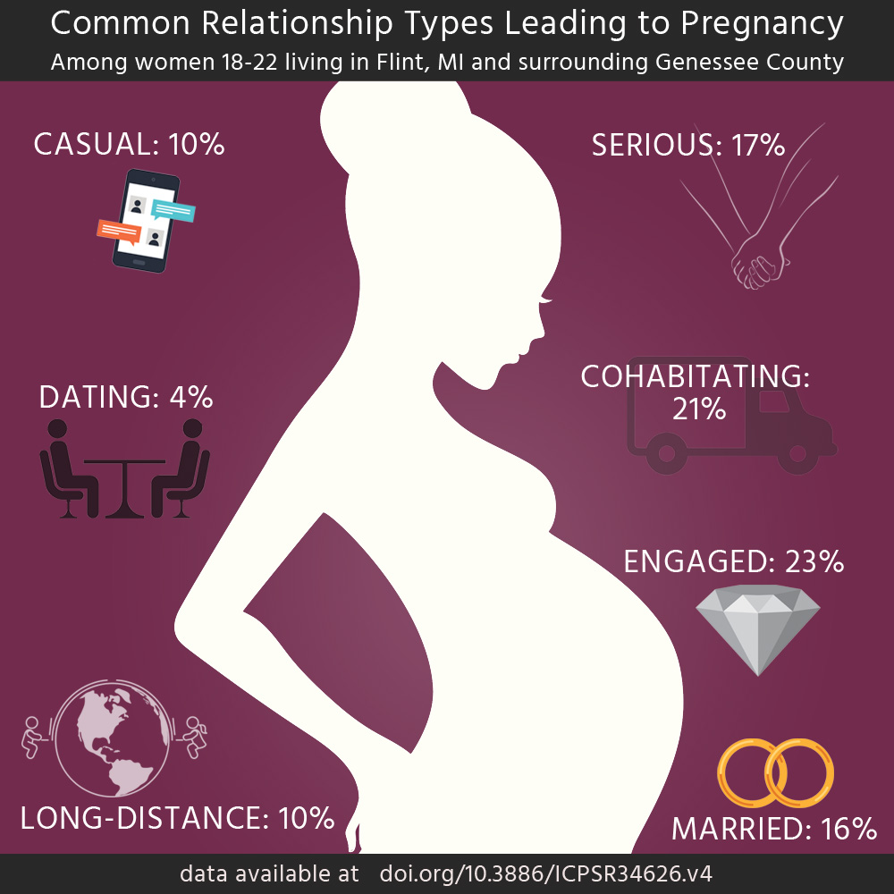
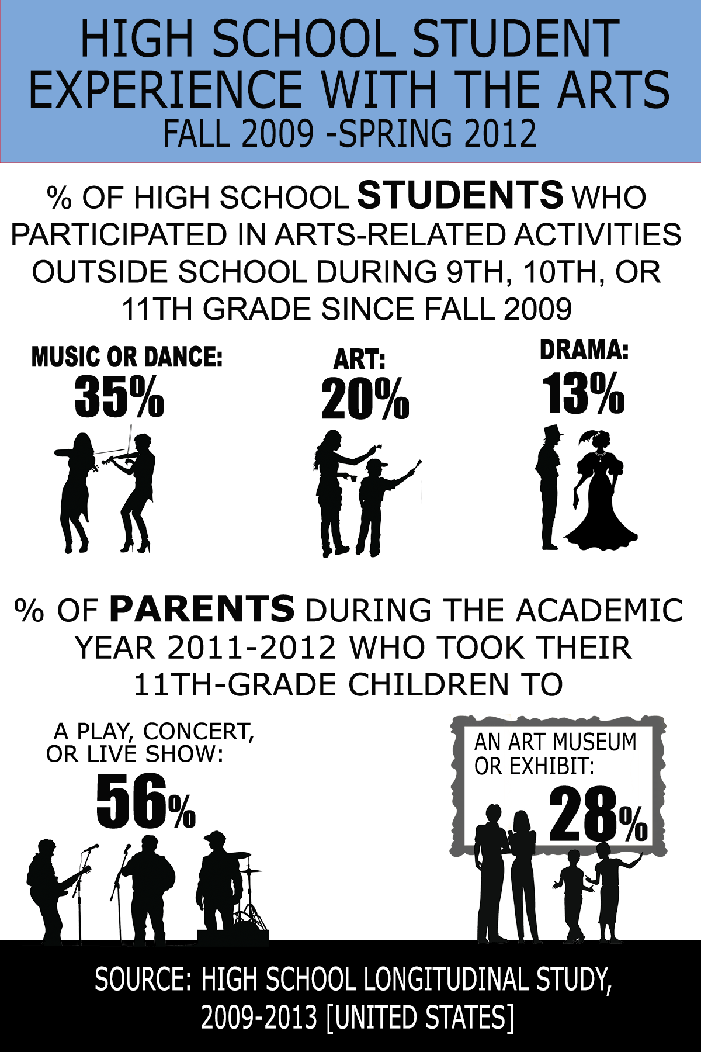
Creating
Infographics
to reach
Community Partners
Notes:
One of the ways we reach communities and broader public is developing infographics and data visualizations. The infographic of the left is a new infographic about pregnancy in Flint and GC.
Infographics are an accessible way to summarize data and inform the public. However, selecting what to present to the public can be subjective. We select priorities for infographics wand data visualization with input from our community partners.

Slide 7

Bringing
Training
to Community Partners in Flint
opendataflint.org Thank You!
Notes:
Data without the ability to use it is simply less valuable. ICPSR is known for training in data and data use – mainly to research audiences.
We will take our training to the Flint community next summer and promote the Ann Arbor summer program in the Flint community.
We aim to increase data literacy in the community and to help user audiences including infomediaries and citizen scientists use the Flint data at a higher level.
We believe that Open Data Flint is a model for increasing community access and capacity for data as well as ensuring the data is accessible for the long-term because it is part of a sustainable repository.
Thank you.

